Slide 1
Project 1, Module 3
Lucas Ross

Slide 2
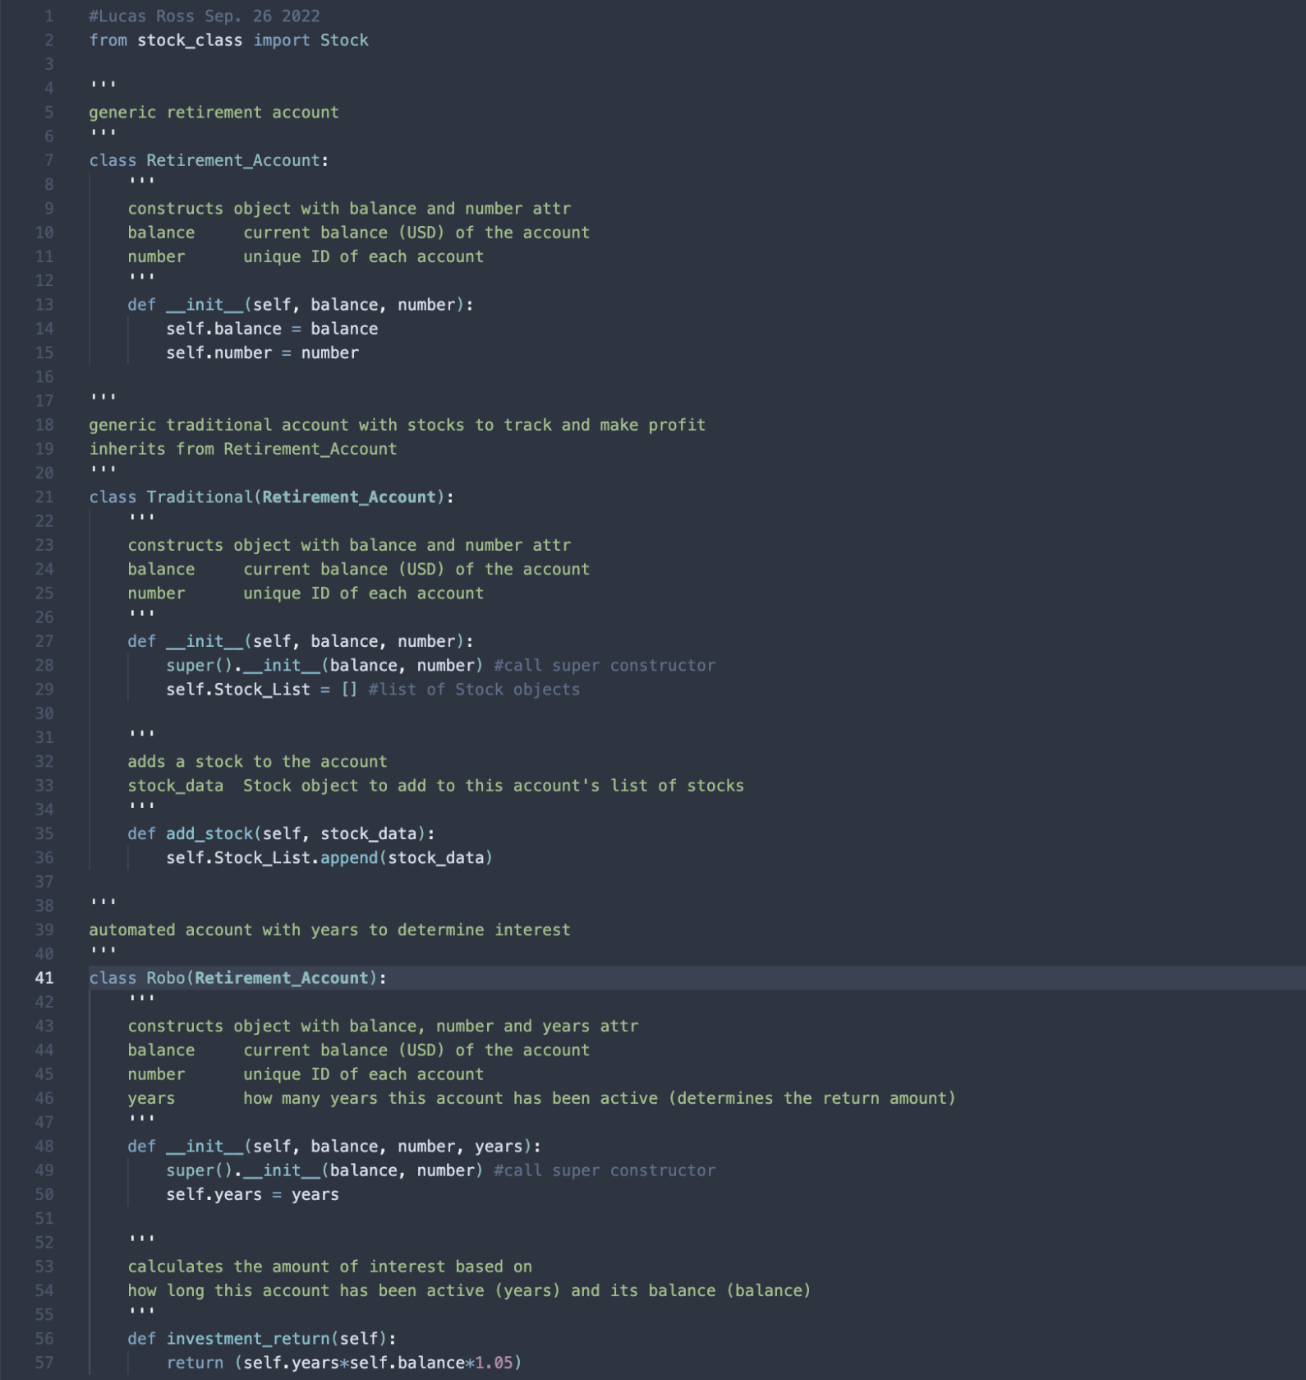
Inherited classes
Classes:
Retirement_Account
Traditional
Robo

Slide 3

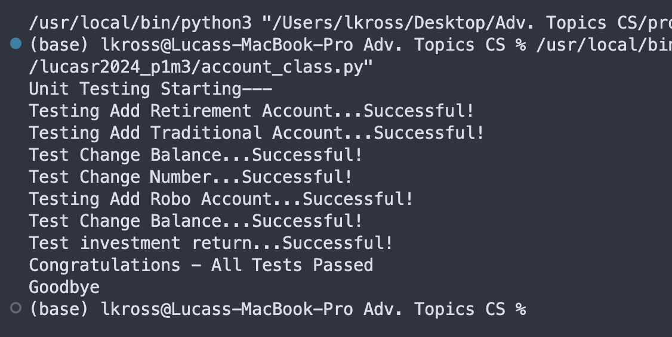
Unit Tests
Successful unit test of the Traditional and Robo classes.

Slide 4
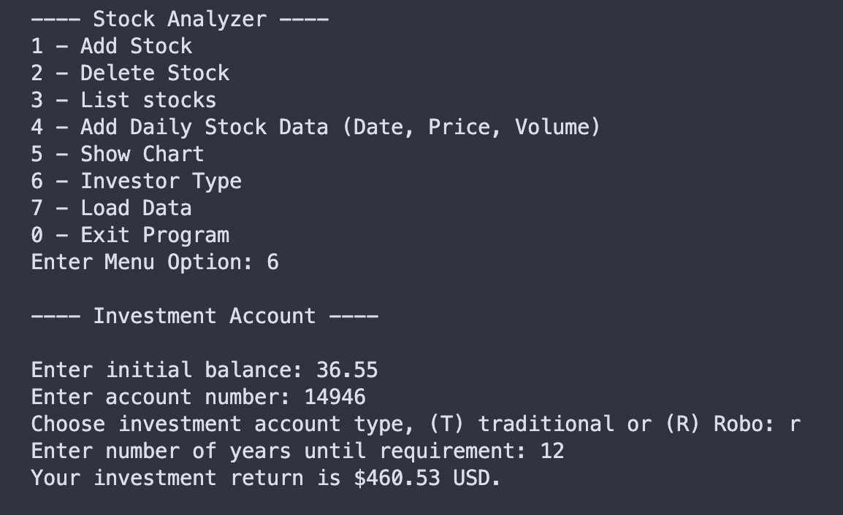
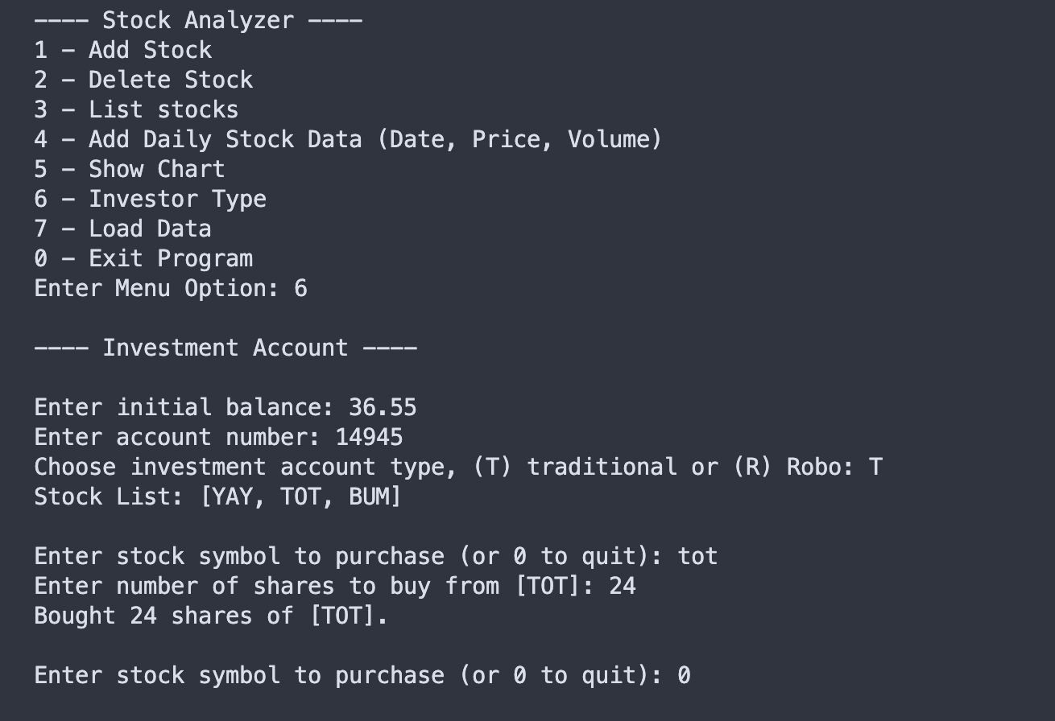
Stock menu program
Testing the Robo class with investment_type()
Testing the Traditional class with investment_type()

